Slide 1


Minor Project
Driver Drowsiness Detection System
Presented by:
R2142201059 -Sejal Anand
R2142201505 -Anshul Chamoli
R2142201530 -Bhavya Sharma
Mentored By:
Dr. Sumit Varshney

Slide 2
Content
Introduction
Literature Review
Objectives
Methodology
Working Model
Results
Conclusion
References

Slide 3
Introduction
According to a study, 21 percent of fatal accidents are caused by drowsiness in drivers and as per the estimates of National Highway Traffic Safety Administration (NHTSA) every year, 100,000 road accidents are driver fatigue related.
Accident prevention is a major challenge and development of technology provides us with advanced solutions to problems of road catastrophes. If the state of drowsiness can be perceived in a driver at early stages, the driver can be alerted and accident can be averted.
A machine learning approach can be used to build a real-time machine-vision system, which helps in detection of drowsiness in driver and alerts the driver.

Slide 4
Motivation
The primary motivation behind developing driver drowsiness detection systems is to improve safety on the roads. A drowsiness detection system can help prevent these accidents by providing drivers a convenient way to monitor their fatigue levels and take breaks when necessary.

Slide 5
Problem Statement
To detect drowsiness in drivers by identifying the facial features of the driver by capturing optical cues and using image processing technology while generating alert signals in appropriate response to the detection.

Slide 6
Area of Application
The system shall be used as an accident prevention technology to detect drowsiness and tiredness in drivers. The system can be useful in any situation where driving or operating machinery for extended periods may result in fatigue and loss of alertness. Some areas of application are transportation industry, automotive industry and aviation.

Slide 7
Data and Input format
A video or live video serves as an input to capture the driver's face. The input can be taken through an acquisition system that maybe a webcam, a portable camera or a visual sensor.

Slide 8
Literature Review
The study by Prajwal B S [1] proposed a system that is able to detect tiredness by watching the eyes and the inputs given to these systems are face landmarks which are collected from face landmarks detection. An alert module is additionally implemented with messaging features as well.
Rohit Chinthalachervu et al. [2] designed a system for the identification of drowsiness by implementing the machine learning algorithms and visual behavior features like Eye Aspect Ratio, Mouth Opening Ratio and Nose Length Ratio, which were recorded using webcam.
Jayasenan J. S [3] introduced a system to localize the eyes and monitor fatigue was developed and the system was able to decide if the eyes are opened or closed.

Slide 9
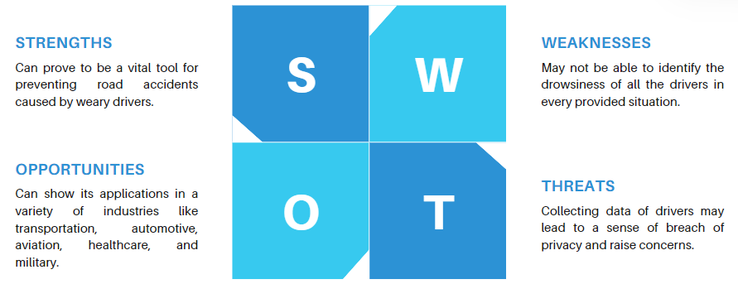
SWOT Analysis

Slide 10
Objective
The main objective is to build a machine learning-based system that identifies the state of drowsiness in drivers given a driving environment and generate an appropriate response to the detection and alert the driver to help prevent accidents caused by tiredness and drowsiness.
1. To detect drowsiness in drivers as an accident prevention system.
2. To build a machine vision-based system for the problem.
3. To understand and implement software development process phases.

Slide 11
Methodology
Image processing and machine learning are the two aspects of the suggested strategy; the purpose of the image processing stage is to identify the driver's face and primary function of machine learning is to categorise whether the driver's is feeling drowsy or not.
The prediction involves four steps:
• Extracting features to classify drowsiness on driver’s face.
• Creating a Drowsiness Detection model in Python.
• Creating a notification system alerting the driver to take a break.

Slide 12
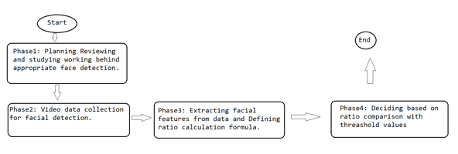
Methodology

Slide 13
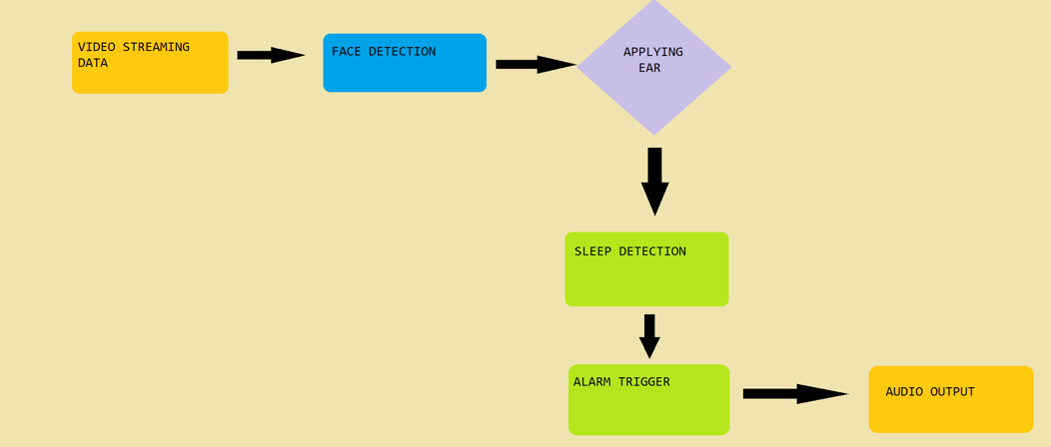
Working Model
Requirement analysis:
https://docs.google.com/document/d/1T1w5jVZoK-IjM2D6RUVkKGrmheUw5W8ZkPSC0961fmM/edit?usp=sharing\
Technical Diagram

Slide 14
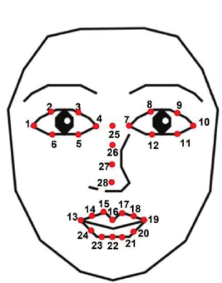
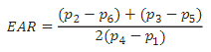
Eye Aspect Ratio
Eye Aspect Ratio (EAR) is inverse ratio of width of eyes to the height of eyes.

Slide 15
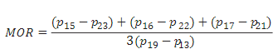
Mouth Aspect Ratio
Mouth Aspect Ratio (MAR) is inverse ratio of width of eyes to the height of eyes.

Slide 16
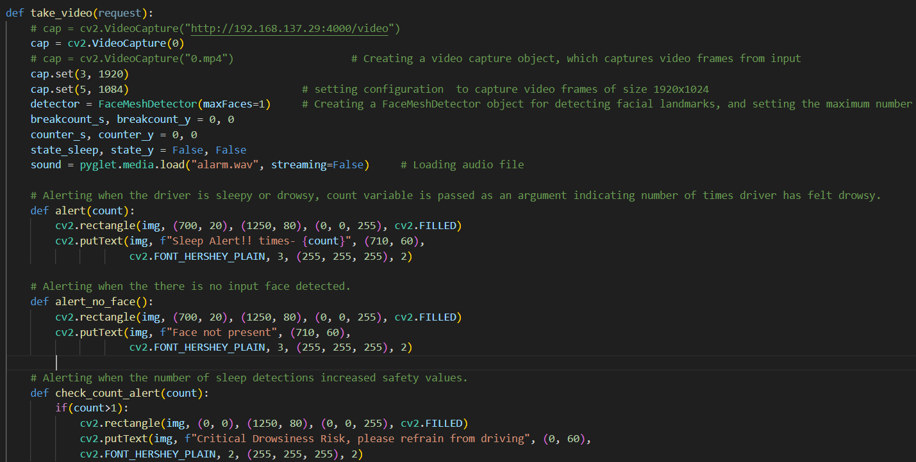
Code

Slide 17
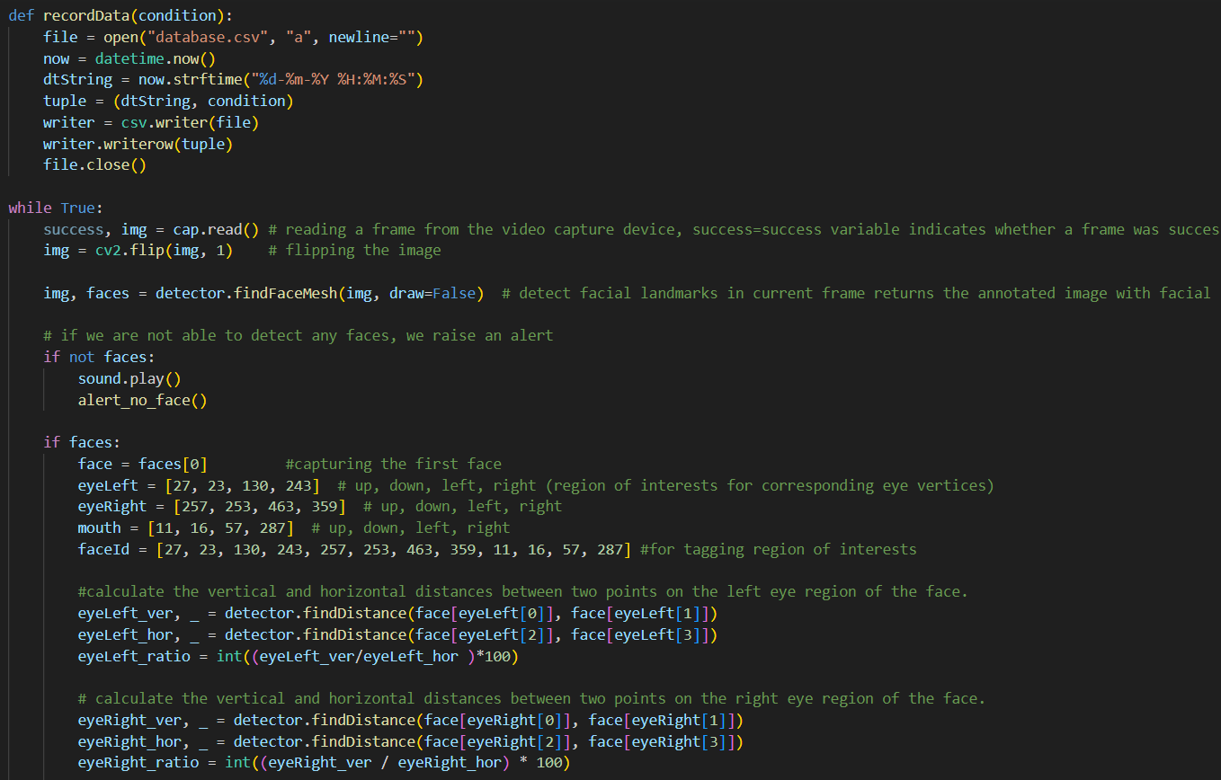
Code

Slide 18
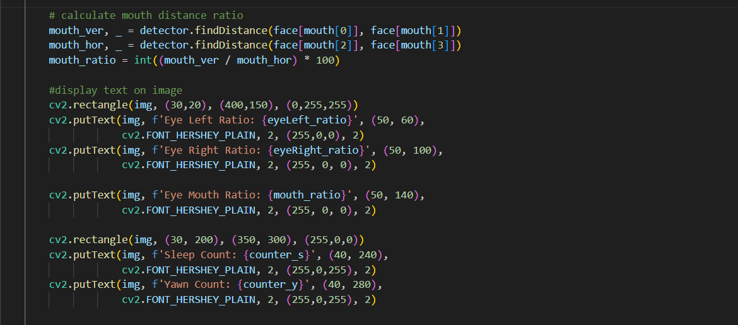
Code

Slide 19
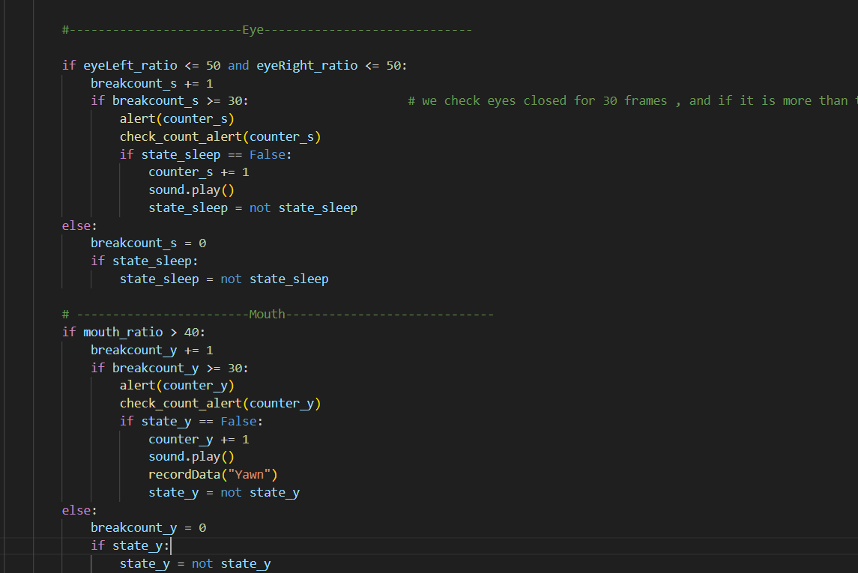
Code

Slide 20
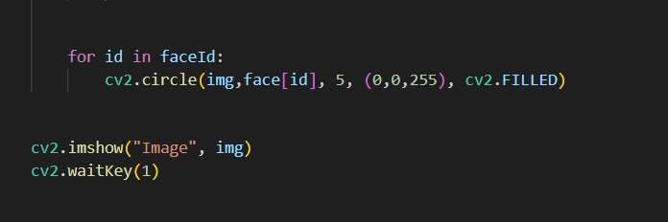
Code

Slide 21
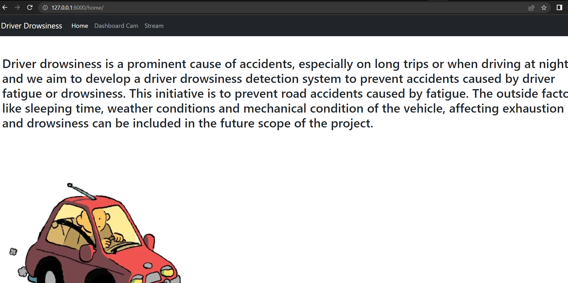
Output

Slide 22
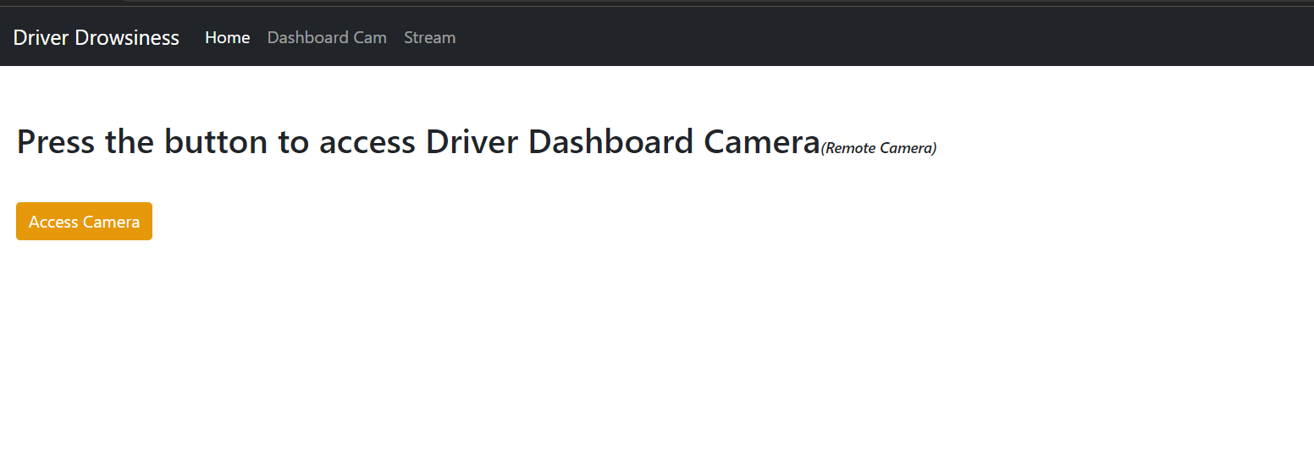
Output

Slide 23
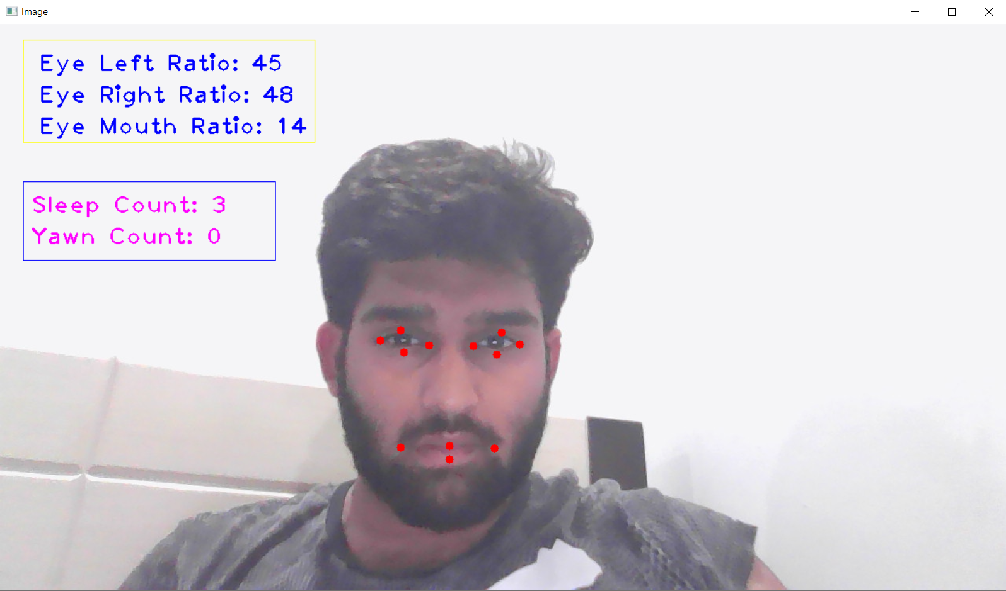
Output

Slide 24
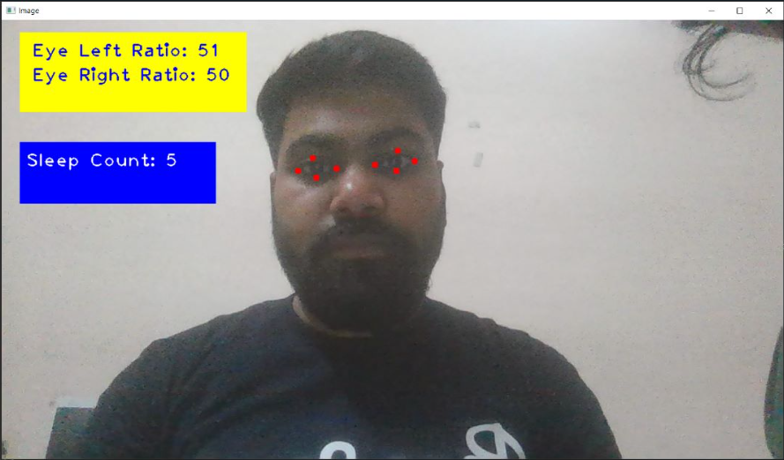
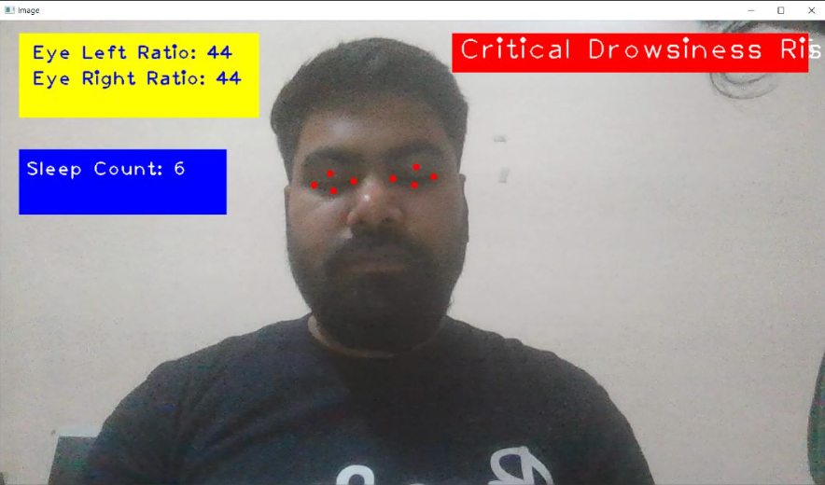
Test Case

Slide 25
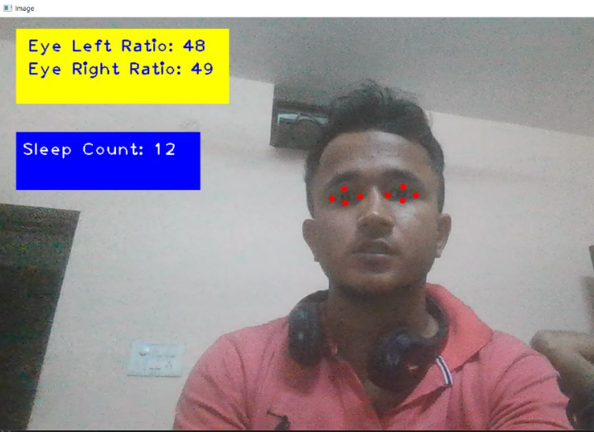
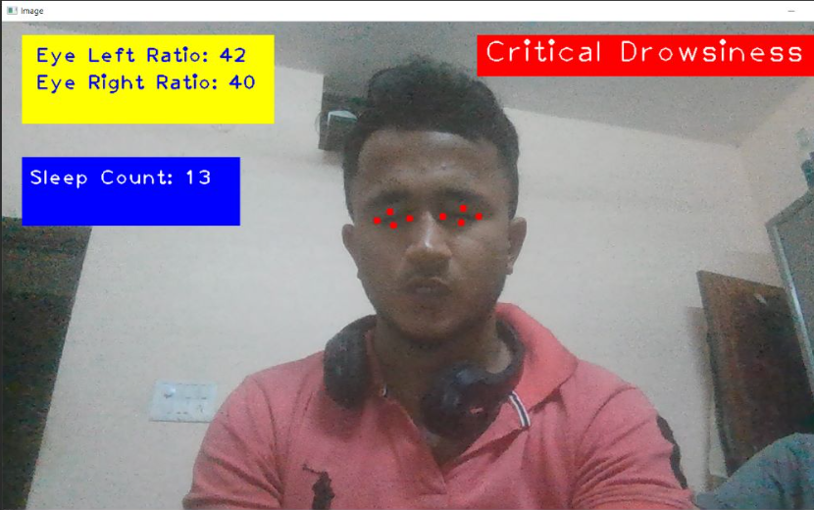
Test Case

Slide 26
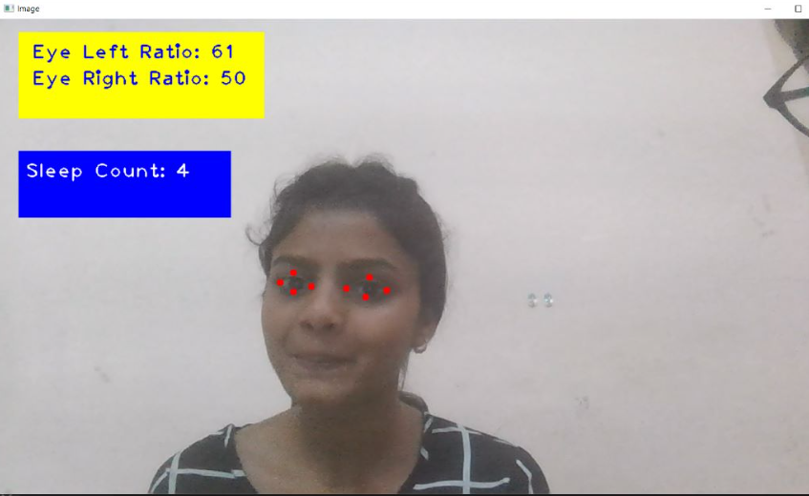
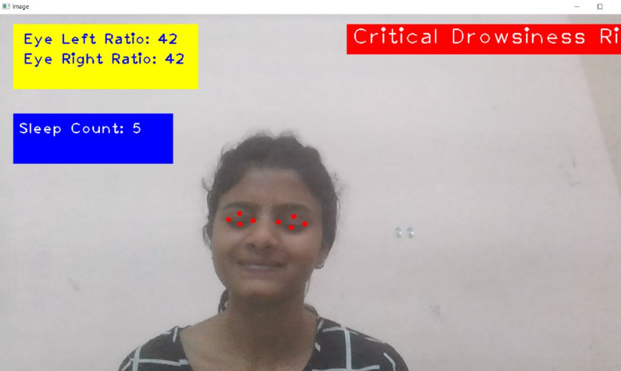
Test Case

Slide 27
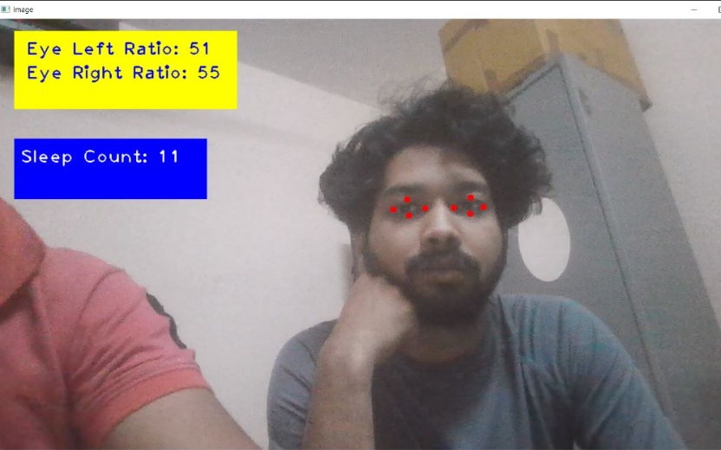
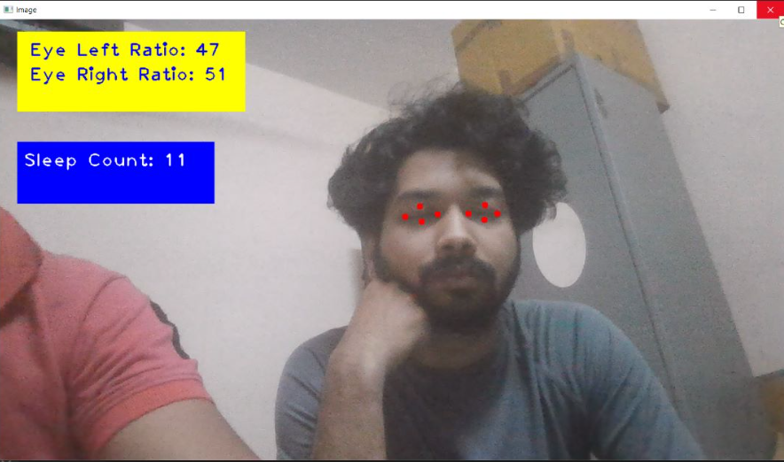
Test Case

Slide 28
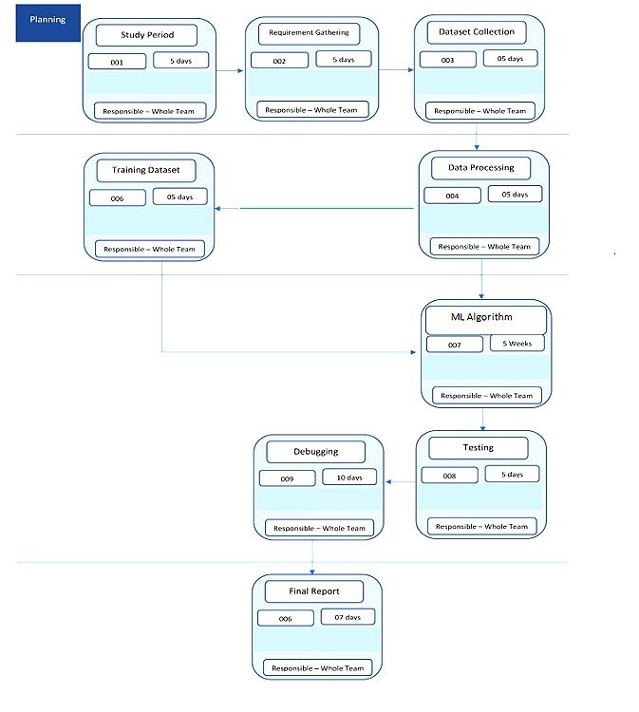
Timeline

Slide 29
Reference
[1] B S, Prajwal. (2022). DRIVER DROWSINESS DETECTION. 10.13140/RG.2.2.28437. 40161.
[2] Chinthalachervu, Rohith & Teja, Immaneni & Kumar, M. & Harshith, N. & Kumar, T.. (2022). Driver Drowsiness Detection and Monitoring System using Machine Learning. Journal of Physics: Conference Series. 2325. 012057. 10.1088/1742-6596/2325/1/012057.
[3] S, Jayasenan & P S, Smitha. (2014). Driver Drowsiness Detection System. IOSR journal of VLSI and Signal Processing. 4. 34-37. 10.9790/4200-04113437.
[4] Rode, Manoj & Bethi, Anirudh & Baddam, Santosh & Laxmi, Bala & Kondaveti, Prasanna & Gadipally, Tejaswini & Katroth, Naresh. (2022). Driver Drowsiness Detection Using Machine Learning. International Journal for Research in Applied Science and Engineering Technology. 10. 10.22214/ijraset.2022.47516.

Slide 30
Thank You

